Slide 1

ATAR CHEMISTRY
MOLAR VOLUME
And
Volume to Volume Calculations

Slide 2
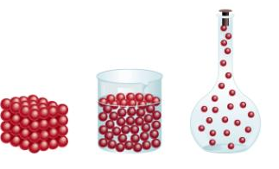
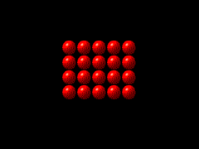
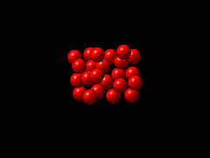
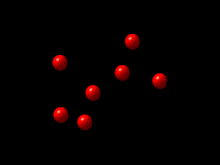

Slide 3
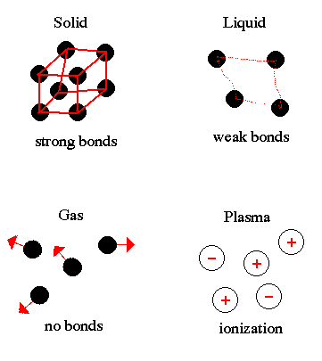

Slide 4
BEHAVIOUR OF GASES
► In gases the molecules behave as though they are almost independent of each other. There is much more space between molecules and, for similar conditions of pressure, temperature, and volume, the space occupied by a given number of molecules of any gas is much the same.
► This property of gases was suggested by Avogadro in his hypothesis which is now so well accepted that it is known as Avogadro’s Law :
“Equal volumes of ALL gases, under the same conditions of temperature and pressure contain the SAME number of molecules.”
►For convenience in comparing measurements on gases, it is customary to make measurements under standard conditions, S.T.P. (Standard, Temperature and Pressure).
►S.T.P. is normal atmospheric pressure 100 kpa (1 atm) and 273K (0⁰C).
►Under S.T.P. conditions it is found that 1 mole of any gas occupies a volume of 22.71 litres and is known as its molar volume.

Slide 5
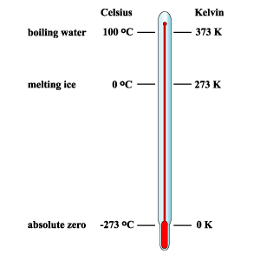

Slide 6
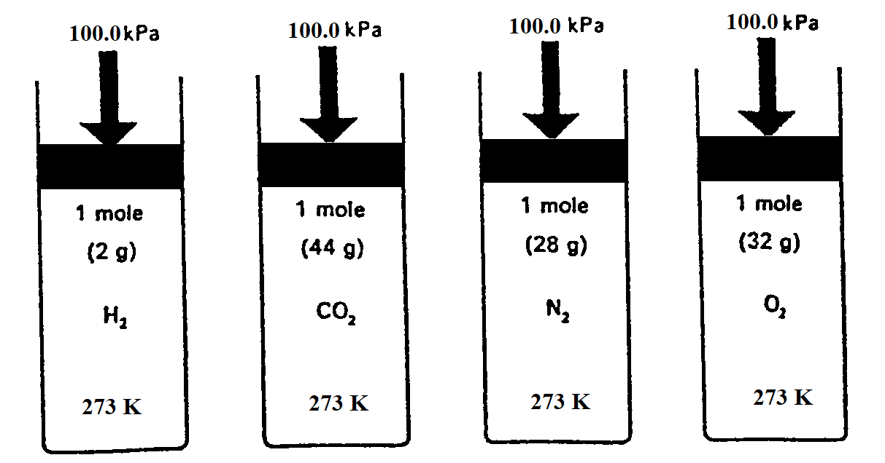
Comparison at any Temperature and Pressure
EQUAL VOLUMES BUT NOT EQUAL MASSES

Slide 7
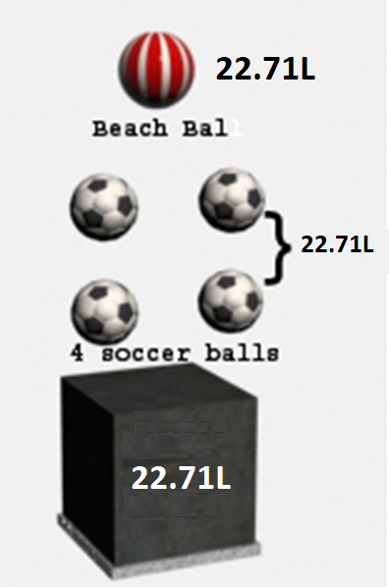

Slide 8
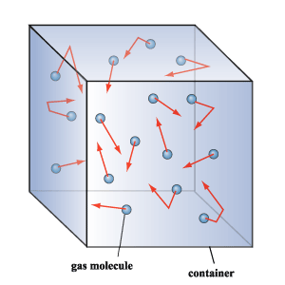

Slide 9
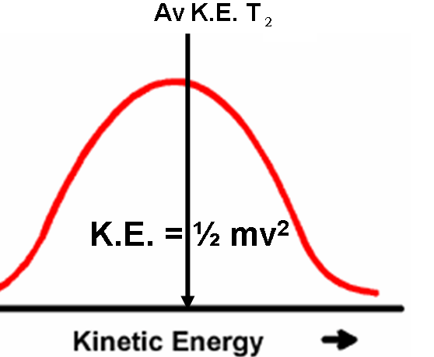
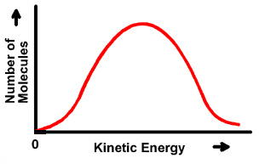
Kinetic Energy Distribution Curve
Av K.E. T₁
K.E. = ½ mv²

Slide 10
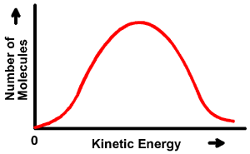
Molecules in Motion
So n= V/22.71
volume in Litres
VELOCITY OF GAS MOLECULES
Relative velocities of different gases at the
SAME TEMPERATURE:
Same K.E. Energy Distribution as the Temperature is the same!
H₂
CO₂
Punching Power
SAME!
=
½ m_{H2} v_{H2}²
½ m_{CO2} v_{CO2}²

Slide 11
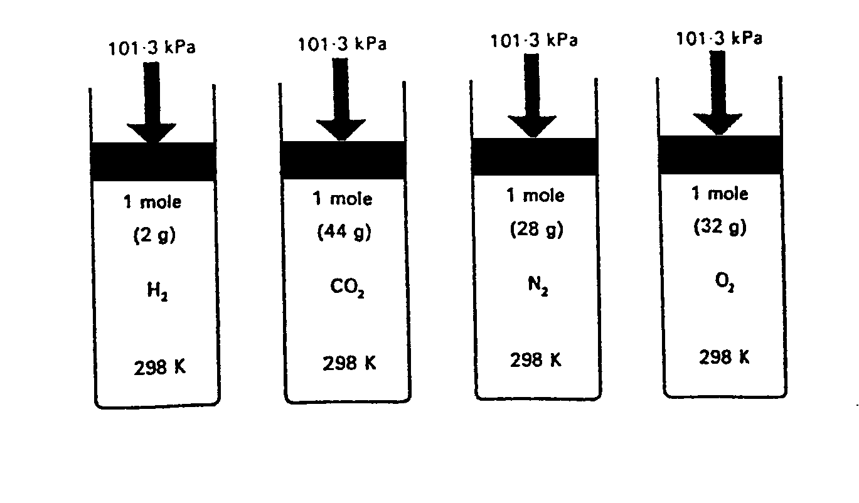

Slide 12
MOLE ►VOLUME ► MASS CONVERSIONS
►Calculate the missing entries in the chart (3 S.F.):
GAS | MOLES | MASS | VOLUME
O₂ | 21.4 | 686g | 487L
H₂ | 55.5 | 112g | 1,260L
N₂ | 53.5 | 1.5kg | 1,220L
HCl | 0.0110 | 0.401g | 250mL
1
2
3
4
5
6
7
8

Slide 13
MASS ► VOLUME
CALCULATION

Slide 14

► Gas calculations are often easier than traditional mass to mass calculations as the volume of ALL gases are the same!
► The only difference with this type of calculation is that instead of answering in grams we convert the mole quantity to a VOLUME at the last step in the calculation.

Slide 15
QUESTION 1 : MASS ► VOLUME
Hydrochloric acid can be oxidised to chlorine (Cl₂) by oxidising agents such as manganese (IV) oxide:
MnO₂(s) + 4HCl(aq) → MnCl₂(aq) + 2H₂O(l) + Cl₂(g)
If 183g of HCl is reacted with excess MnO₂, what VOLUME of Cl₂ will be produced at S.T.P?

Slide 16
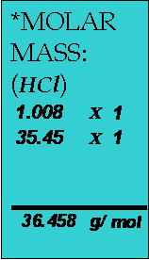
EQUATION:
√ ?
MnO₂(s) + 4HCl(aq) → MnCl₂(aq) + 2H₂O(l) + Cl₂(g)
MASS → MOLES (√ ):
n(HCl) = m
*M
= 183
36.458
∴ n(HCl) = 5.019 mol
MOLE RELATIONSHIP ( ? →√ ):
n(Cl₂) = ¼ x n(HCl) (General)
= ¼ x 5.019 (Insert Specific quantity)
∴ n(Cl₂) = 1.255 mol (Mole quantity of unknown)
MOLES → VOLUME(? ):
V(Cl₂) = n x 22.71 (S.T.P.)
= 1.255 x 22.71
∴ V(Cl₂) = 28.501 = 28.5 L (3 S.F.)
Solution

Slide 17
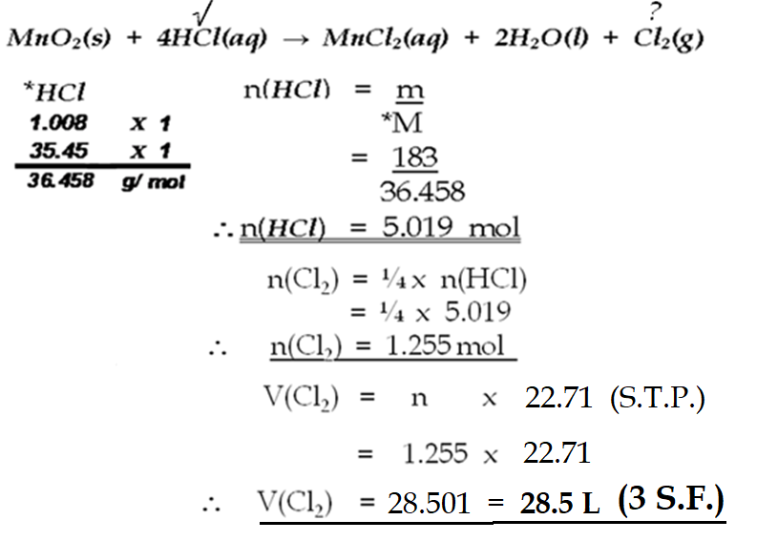
How should it look on your page?

Slide 18
VOLUME ► VOLUME
CALCULATION

Slide 19
► If reactants are gaseous it is easy to give information about mole quantity in volume rather than mass.
► The volume of the product gas can be calculated directly from the mole relationship as an application of AVOGADRO’S LAW!

Slide 20
QUESTION 2 : VOLUME ► VOLUME
Hydrogen chloride gas can be produced when chlorine gas is ignited in the presence of hydrogen gas:
Cl₂(g) + H₂(g) → 2HCl(g)
If 5,000 litres of chlorine is reacted with excess hydrogen, what VOLUME of HCl will be produced at S.T.P?

Slide 21
EQUATION:
√ ?
Cl₂(g) + H₂(g) → 2HCl(g)
VOLUME → MOLES (√ ):
n(Cl₂) = V
22.71
= 5,000
22.71
∴ n(Cl₂) = 220.16 mol
MOLE RELATIONSHIP ( ? →√ ):
n(HCl) = 2 x n(Cl₂) (General)
= 2 x 220.16 (Insert Specific quantity)
∴ n(HCl) = 440.33 mol (Mole quantity of unknown)
Solution
MOLES → VOLUME(? ):
V(HCl) = n x 22.71 (S.T.P.)
= 440.33 x 22.71
∴ V(HCl) = 10,000 = 10,000 L (3 S.F.)

Slide 22
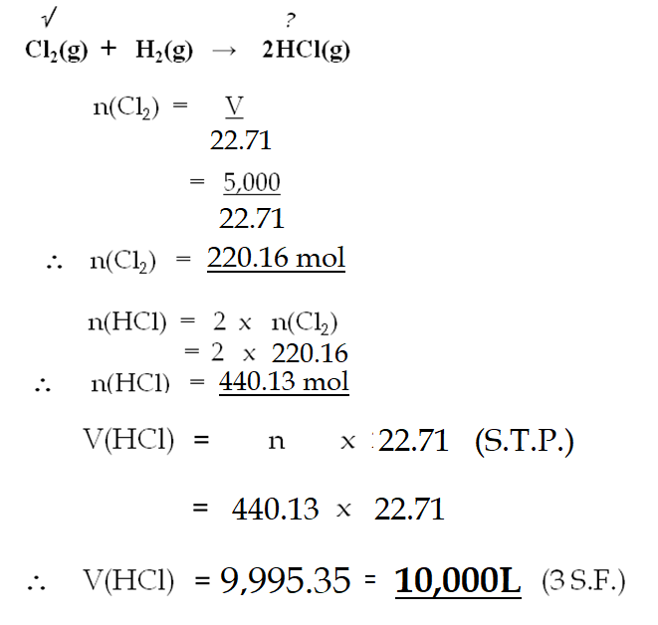
How should it look on your page?

Slide 23
► You will notice that the volume of HCl is twice the original starting volume of the Cl₂. Because the HCl is produced in a 2:1 mole ratio and the volume of a mole of ALL gases is the SAME this stands to reason!
► This problem could have been solved with a straight VOLUME to VOLUME ratio!
► V(HCl) = 2 x V(Cl₂)
= 2 x 5,000
= 10,000 L

Slide 24
► This approach can also be used in situations where two gaseous reactants are detailed. This simply means that the problem becomes a LIMITING REACTANT problem in the context of gases!

